Slide 1
Employee Data Analysis using Excel
STUDENT NAME:JANAKIRAMAN.D
REGISTER NO: 122203391
AD1BAF915D19E4DAFB24FF041BB341DA
DEPARTMENT: B.COM (CS)
COLLEGE: ST .THOMAS COLLEGE OF ARTS AND SCIENCE

Slide 2
PROJECT TITLE
Creating an Employee Performance Scorecard in Excel

Slide 3


AGENDA
Problem Statement
Project Overview
End Users
Our Solution and Proposition
Dataset Description
Modelling Approach
Results and Discussion
Conclusion
3/21/2024 Annual Review

Slide 4

PROBLEM STATEMENT
1.Formula errors or inconsistencies.
2.Data formatting and alignment issues.
3.Difficulty creating chart or visualization.
4.Challenges with calculating weighted scores or averages.
5.Trouble linking data from multiple sheets or sources.

Slide 5

PROJECT OVERVIEW
OBJECTIVE:
*Develop a scorecard that provides a clear and
Objective assessment of employee performance.
*Enable managers to identify area of strength and
Weakness ,and make data-driven decisions.
SCOPE:
*-Dashboard sheet(e. g., chart , graphs , summaries)
* It calculate performance scores and ratings ensure
Data integrity ,accuracy ,and consistency throughout the template.
Timeline:
*Finalize template, guide, and sample dataset(if applicable).

Slide 6

WHO ARE THE END USERS?
1.HR
2.Managers. *They will utilize the employee
3.Employee. Performance scorecard in excel
4.Department heads. To drive business outcomes.
5.Senior leadership.
6.Talent management teams.
7.Compensation and benefits teams.
8.Training and development teams.

Slide 7

OUR SOLUTION AND ITS VALUE PROPOSITION
1.Data-driven decision making:
*Decisions about employee performance and compensation with accurate
And real-time data.
2.Streamlined management:
*Evalutions goal setting and tracking with a user-friendly excel template.
3.Improved engagement:
*Motivation and growth with regular feedback, couching development opportunities.
4.Enhanced collaboration:
*Transparency accountability and teamwork with shared performance goals and metrics.

Slide 8
Dataset Description
This dataset contains information about employee performance, including demographic, job-related, and performance metrics.
*{(e.g., Employee ID , Name, Job Title, Department, and ETC.)}
Sample Size: 100 – 10,000.
This dataset analysis organisation ton track measure and identify areas for improvement and make data-driven decision.

Slide 9
THE "WOW" IN OUR SOLUTION
Performance level formula used in the analysis:-=IFS(Z8>=5,"VERY HIGH",Z8>=4,"HIGH",Z8>=3,"MED","TRUE","LOW")
3/21/2024 Annual Review
9

Slide 10
MODELLING
In the "Employee Performance Analysis Using Excel" project, the modelling phase involves setting up the Excel workbook with various tools and techniques to analyse and visualize the data effectively.Here's how each component will be used Data Filtering Purpose: To sort and refine the data to focus on specific criteria, such as department, date range, or individual employee performance.
Implementation: Excel's filtering feature will be applied to datasets, allowing users to easily narrow down the data to view only the relevant information. For example, filtering by department or by performance rating.
2. Pivot Tables Purpose: To summarize and analyze large datasets by grouping and aggregating data based on different performance metrics.Implementation: Pivot tables will be used to dynamically calculate and display key performance indicators (KPIs) such as average task completion time, total hours worked, or percentage of targets met. This will allow users to view performance metrics by different categories, like employee, team, or month.
10

Slide 11
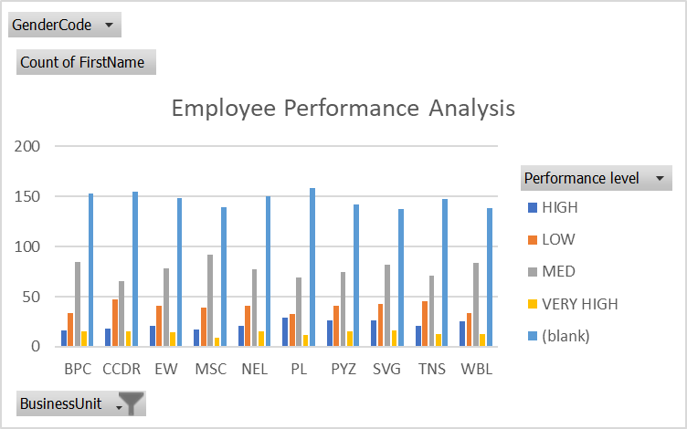
RESULTS
11

Slide 12
conclusion
Key benefits
1.User-friendly and customized design.
2.Automated calculation and data visualization.
3.Real-time performance tracking and monitoring.
4.Improved accuracy and reduced errors.
5.Enhanced collaboration and transparency.

